Slide 1
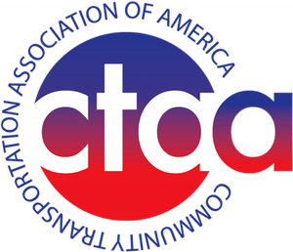
BUILD America and Current Federal Transit Trendlines
Oklahoma Transit Association
Aug. 11, 2026

Slide 2
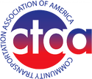
Five-year bill
Bi-partisan
Passed by 62-2 T&I Committee vote
Meets many CTAA member requests
Addresses, but does not solve, Trust Fund solvency
BUILD America 250 Act Key Points

Slide 3
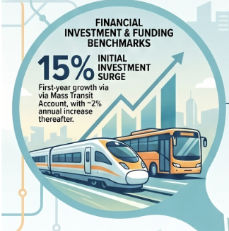
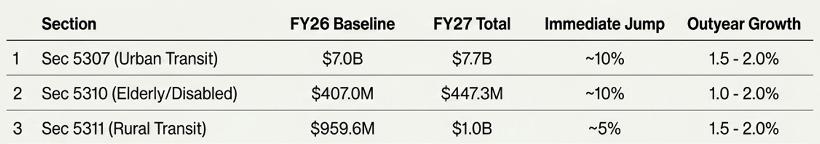
Key Formula Program Funding Levels

Slide 4
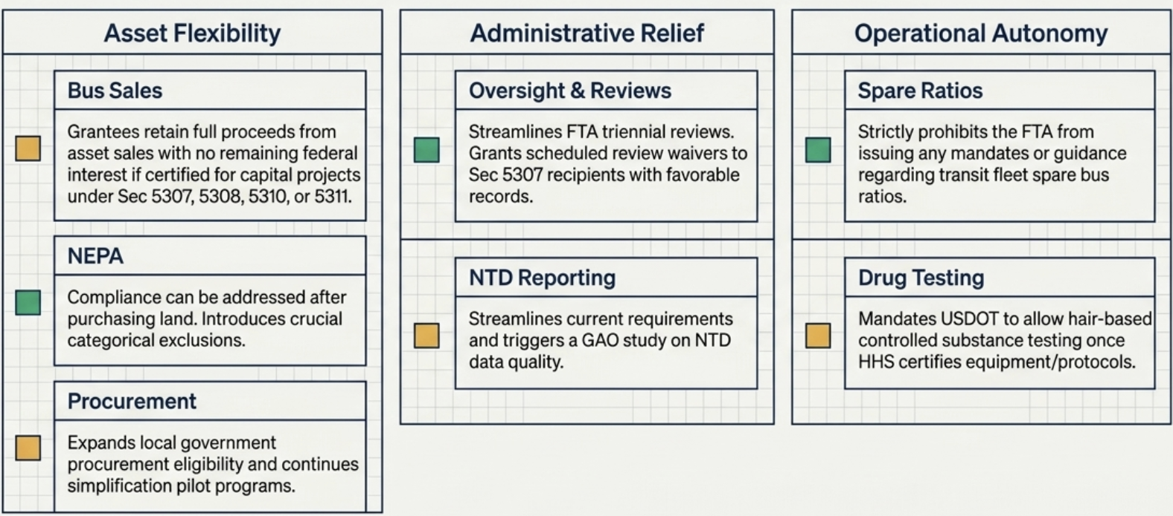
Regulatory Relief Dashboard

Slide 5
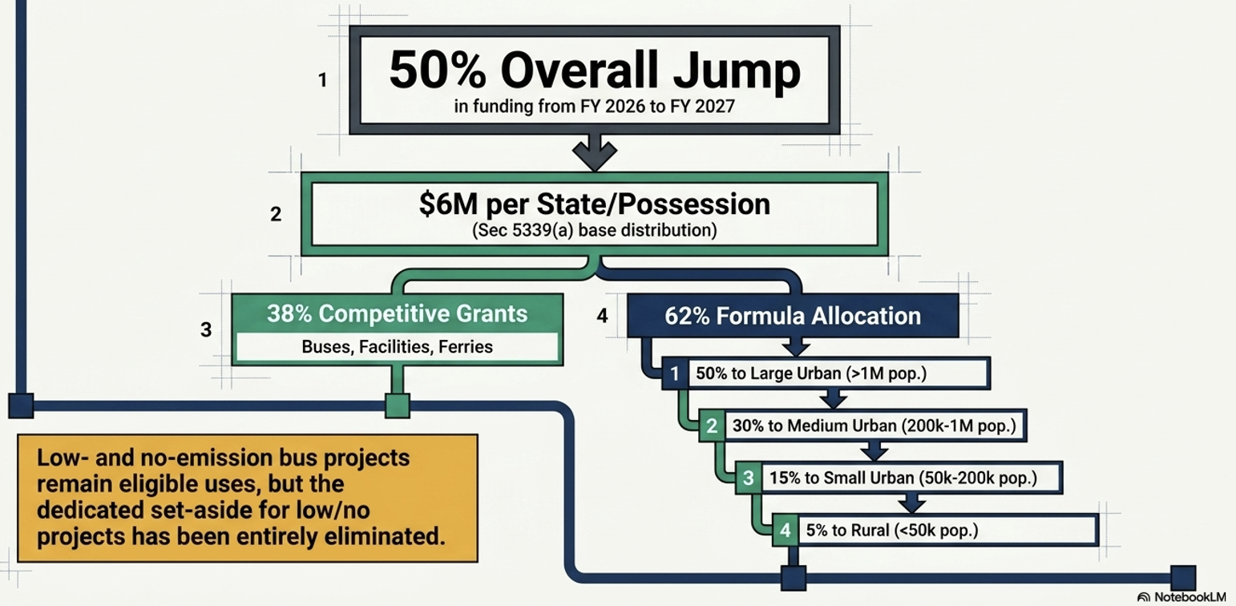
Positive Changes to Sec. 5339

Slide 6
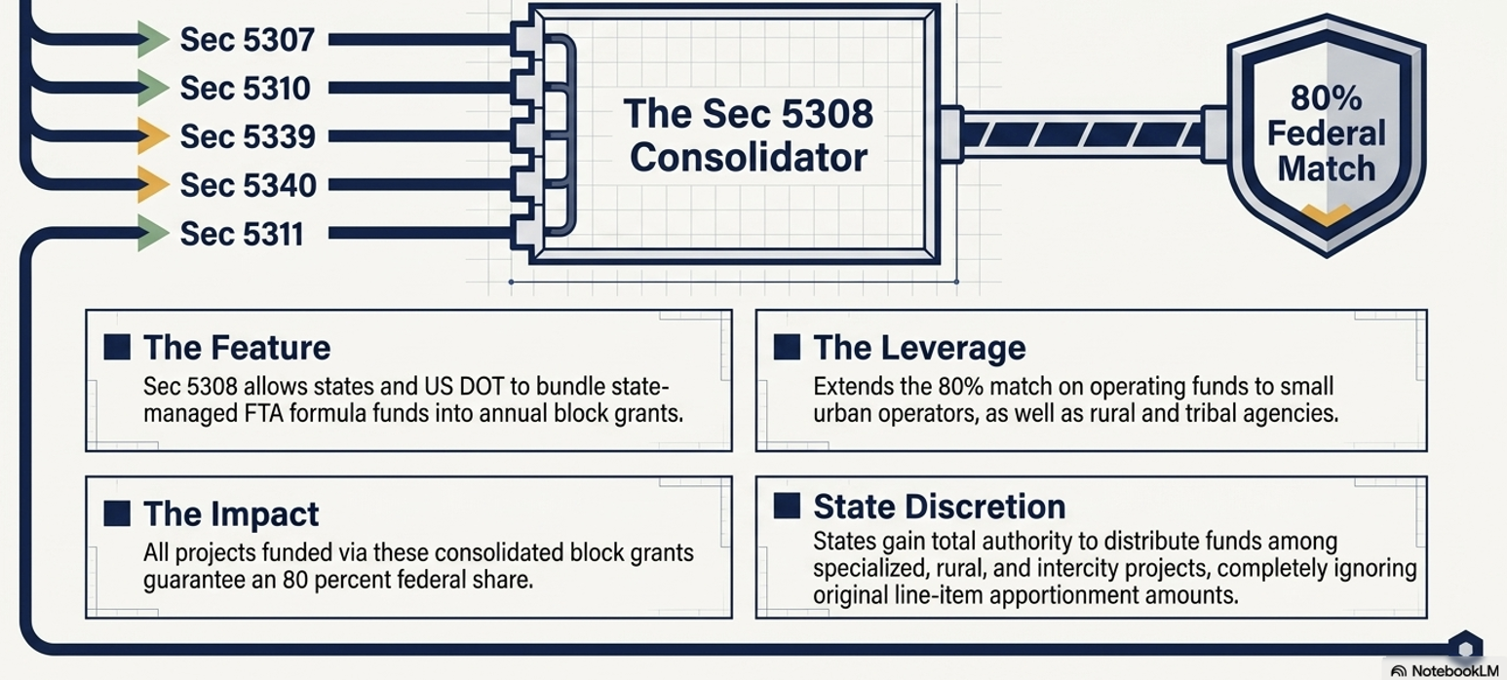
New Sec. 5308 Program Proposed

Slide 7
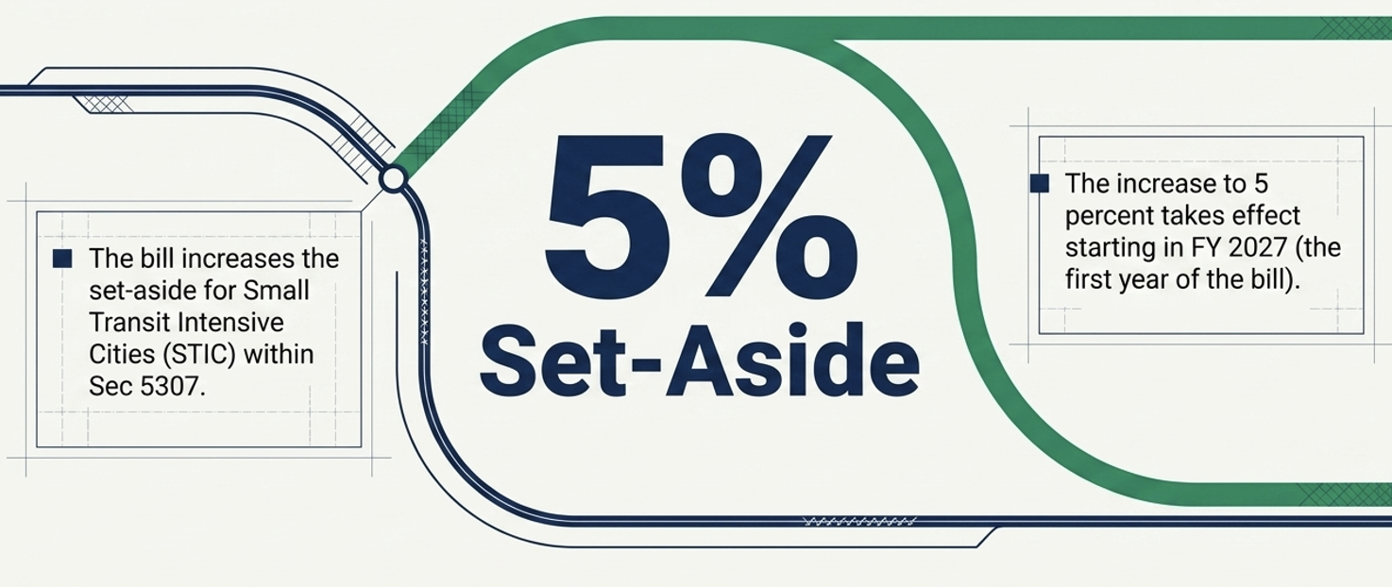
STIC Program would Grow

Slide 8
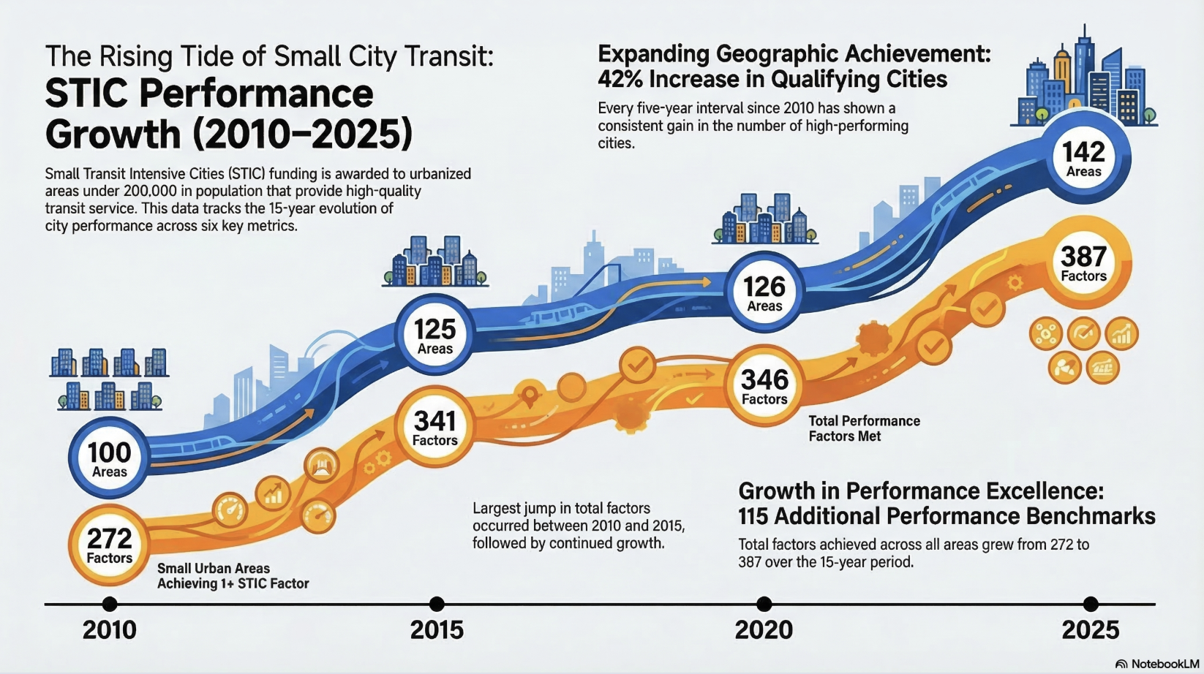

Slide 9
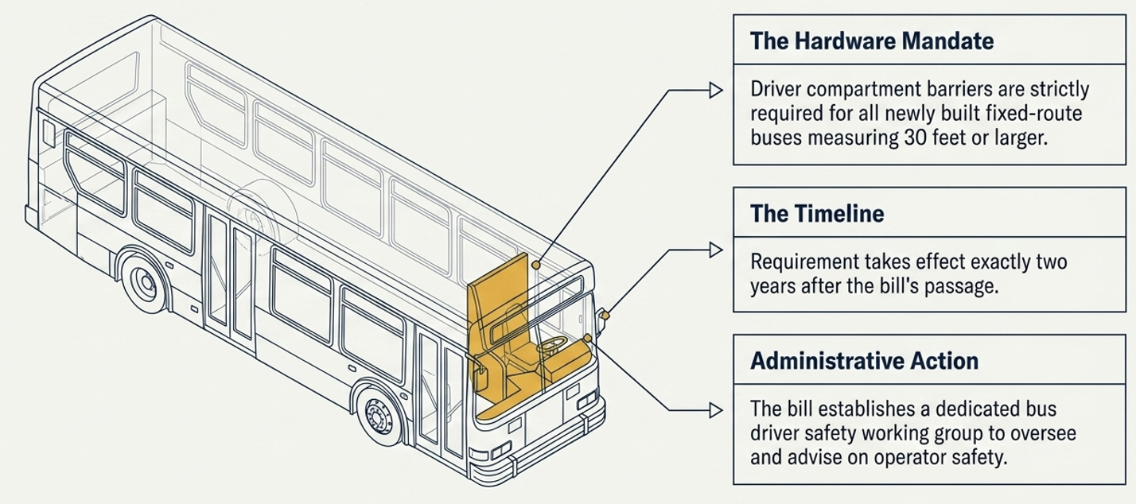
New Mandate: Driver Barriers

Slide 10
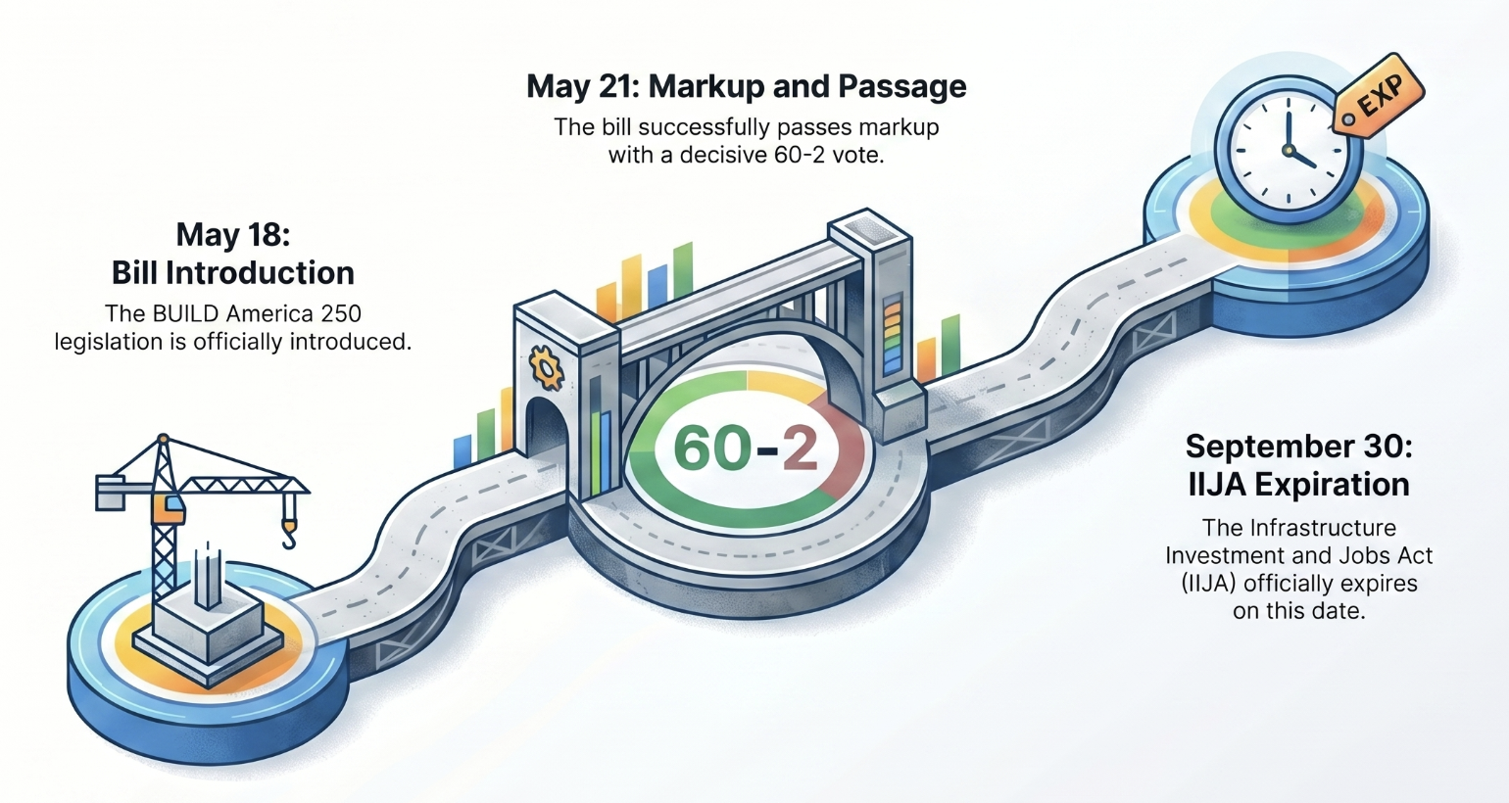
The Reauthorization Timeline

Slide 11
Senate CR Deal Imminent
Passed 89-4 on Monday, Aug. 3
Continues IIJA Funding Levels
House Reaction is Unknown
Postpones OMB Proposed Changes to Uniform Guidance
NO ADVANCED
APPROPRIATIONS

Slide 12
About Advanced Appropriations
Key aspect of IIJA
Fund FRA, FHWA, FAA and FTA
Focus of partisan appropriations fight
Loss would be big hit to transit
CTAA signs onto a number of surface transportation letters

Slide 13
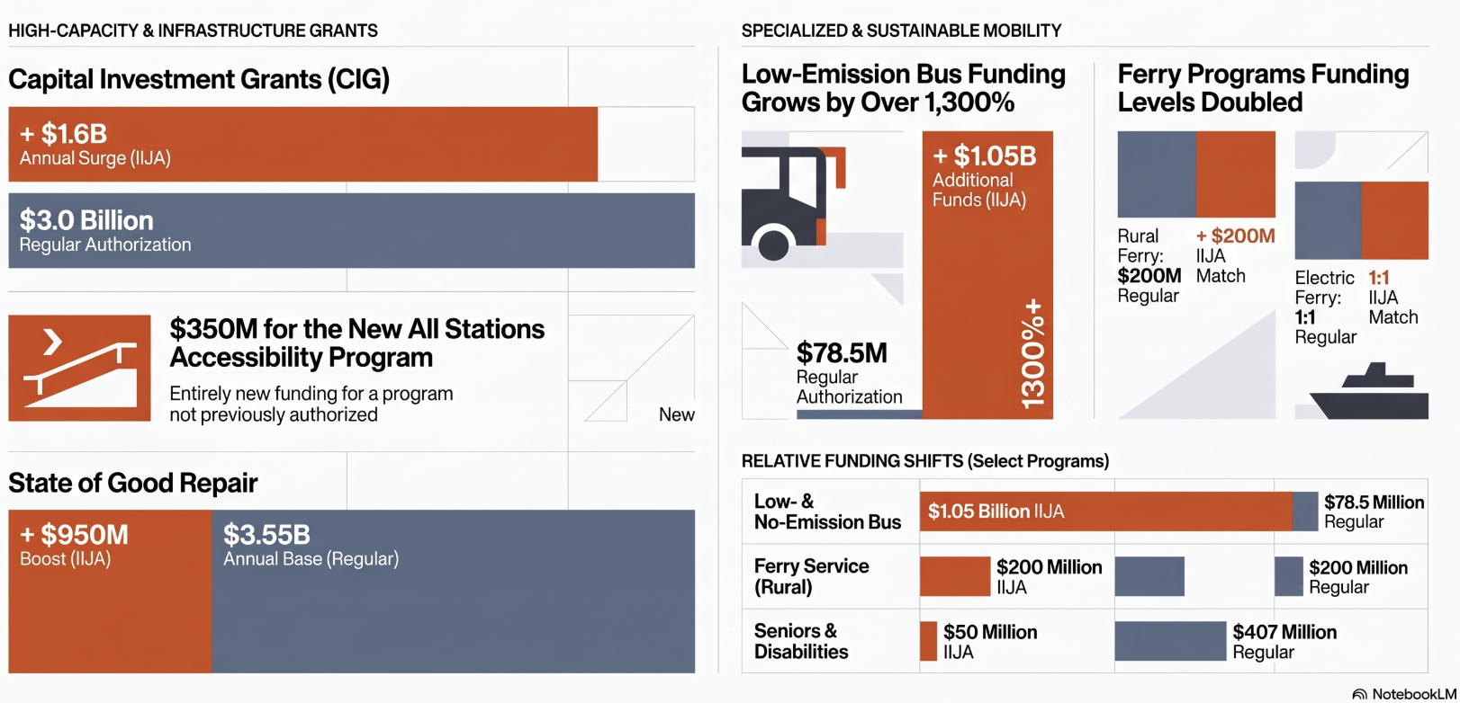
What’s At-Stake with Advanced Appropriations

Slide 14
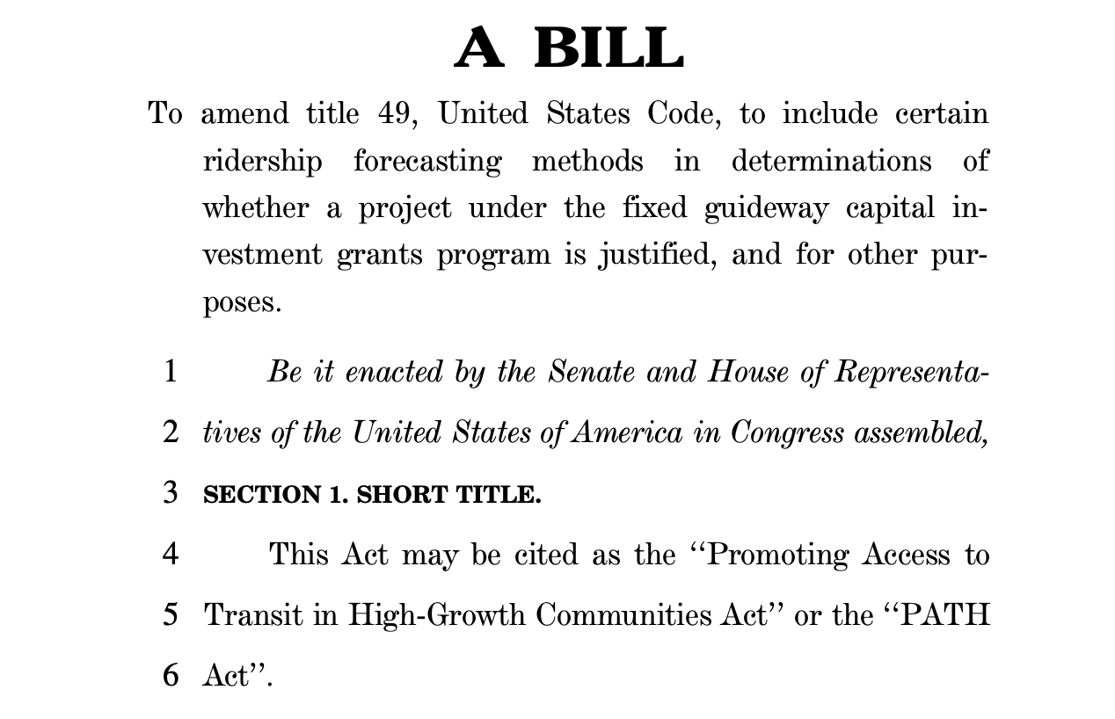
PATH Act Introduced
Updates how ridership calculations are done for CIG
Brings population growth forecasting and TOD into mix
Could bring balance to FTA – CIG decisions
Bi-partisan supported – with Utah reps leading
SUN members should consider talking to members

Slide 15
Federal Transit Trendlines
Safety/
Security weaponization
State DOT & funding challenges
Focus on innovation — AI & AV
NEMT “fraud” and rural health transformation
Bus industry manufacturer crisis
Hard insurance market
Strong local support for transit continues

Slide 16
Contact Me
Scott Bogren
bogren@ctaa.org
Phone
202.247.1921
Website
www.CTAA.org

